Slide 1
SMART AMBULANCE DISPATCH SYSTEM WITH REAL TIME GPS INETGRATION
PIP2001University Project
Review-4
Batch Number: CIT-G035
Roll Number | Student Name
20211CIT0125 | SHAHUL HAMEED
20211CIT0131 | FATIMATHUL SHAHANA
20211CIT0157 | SIMRAN KUMARI
Under the Supervision of,
Mr.Tanveer Ahmed
Assistant Professor
School of Computer Science and Engineering
Presidency University

Slide 2
Introduction
In emergency medical services,timely response is crucial for saving lives. Traditional ambulance dispatch systems often suffer from delays due to inefficient routing, lack of real-time data, and communication barriers.To address these challenges,there is a need for a reliable,scalable and user- friendly Smart Ambulance Dispatch System.
Smart Ambulance Dispatch System utilizes a dedicated Android app for ambulance drivers and a web platform for users to book ambulances. By integrating real-time GPS data and user-friendly interfaces, this system aims to streamline the ambulance booking process and enhance emergency response times.

Slide 3
Research Gaps
1 Lack of Real-Time Ambulance Tracking
Many existing systems lack the ability to track ambulances in real-time, leading to delays and miscommunication between users and drivers.
2. Inefficient Ambulance Allocation
Current systems often allocate ambulances without considering proximity, traffic conditions, or availability, leading to inefficiencies and longer response times.
3. No Traffic-Aware Route Optimization
Most existing methods do not account for real-time traffic data when determining ambulance routes, resulting in delays.
4. Absence of User-Friendly Interfaces
Current systems lack intuitive user interfaces, making it difficult for users to book ambulances during emergencies.

Slide 4
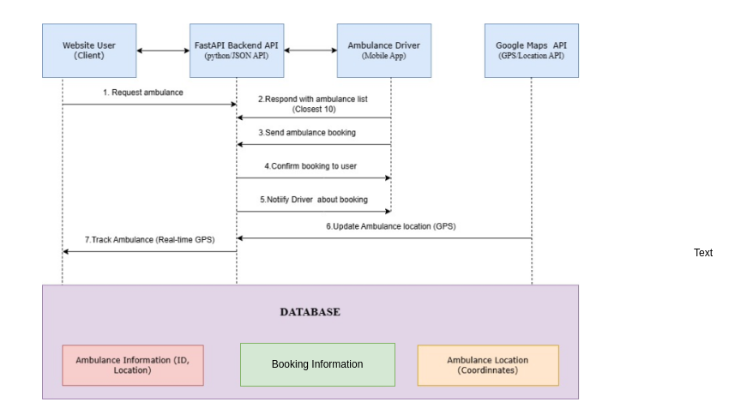
Proposed Methodology

Slide 5
Proposed Methodolgy
The proposed methodology involves the following steps:
1. User Requests an Ambulance (Client Initiation)
2.Request Processing in FastAPI Backend
3. System Fetches Closest Ambulances
4.Ambulance Booking Confirmation
5.Confirmation Notification to User
6.Route Optimization & Live Navigation
7.Live Ambulance Tracking for User
8.Ambulance Arrives & Patient Pickup

Slide 6
Proposed Methodology
To address the limitations of current approaches, this research proposes a smart ambulance dispatch system that integrates real-time GPS technology to optimize ambulance routing and enhance response times.The proposed method consists of the following steps:
User Request & Verification
Ambulance Allocation & Dispatch
Real-Time GPS Tracking & Route Optimization
Ambulance Arrival & Patient Handover

Slide 7
Objectives
The primary objectives of this research are:
Reduce Ambulance Response Time : Minimize the time taken for an ambulance to reach a patient after a request.
Automate Ambulance Allocation Ensure quick and automated assignment of ambulances without manual intervention.
Optimize Emergency Route Planning & Traffic Management : Find the fastest route for ambulances to reach patients and hospitals.
Enable Real-Time Tracking of Ambulances : Track ambulance locations and status in real time to provide updates and manage resources effectively.

Slide 8
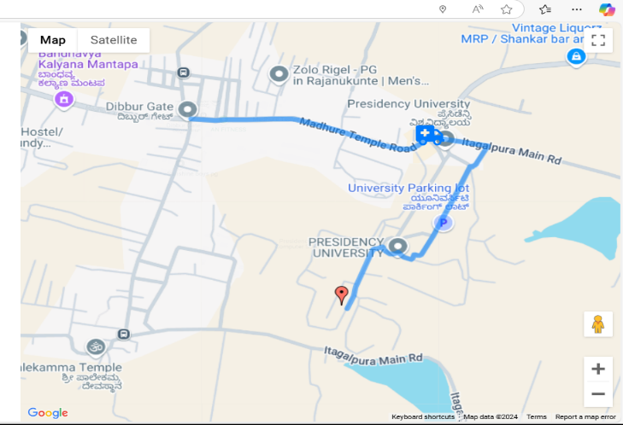
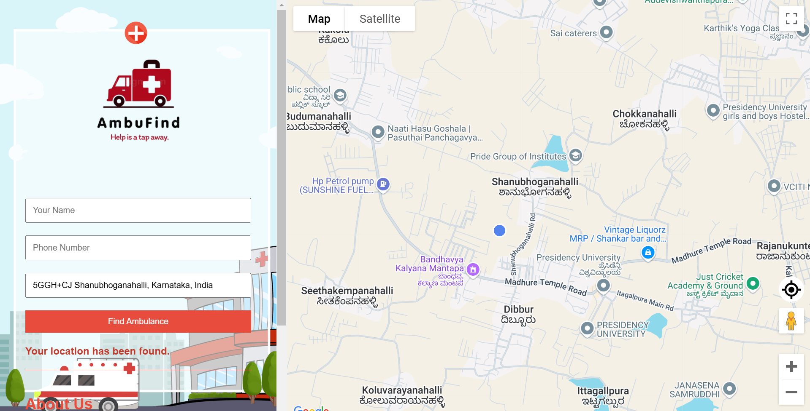
Results
Ambulance Tracking
Website

Slide 9
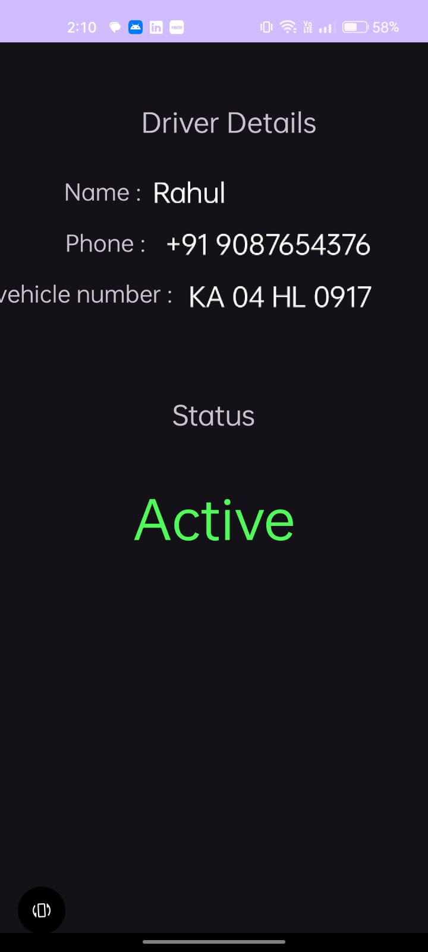
Results
Driver Status

Slide 10
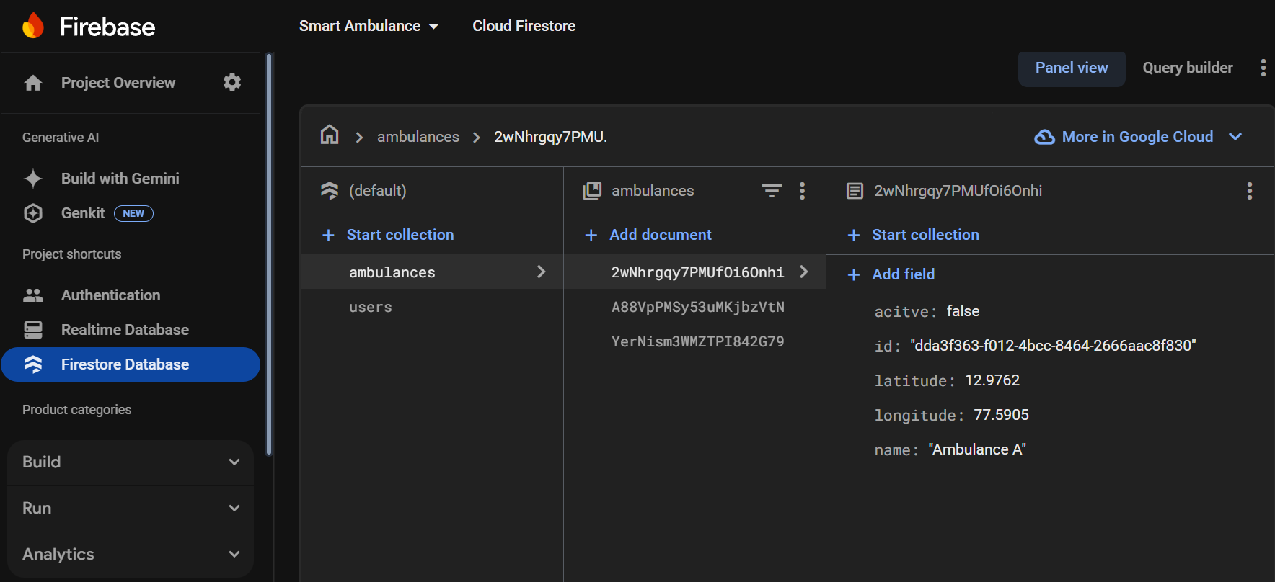
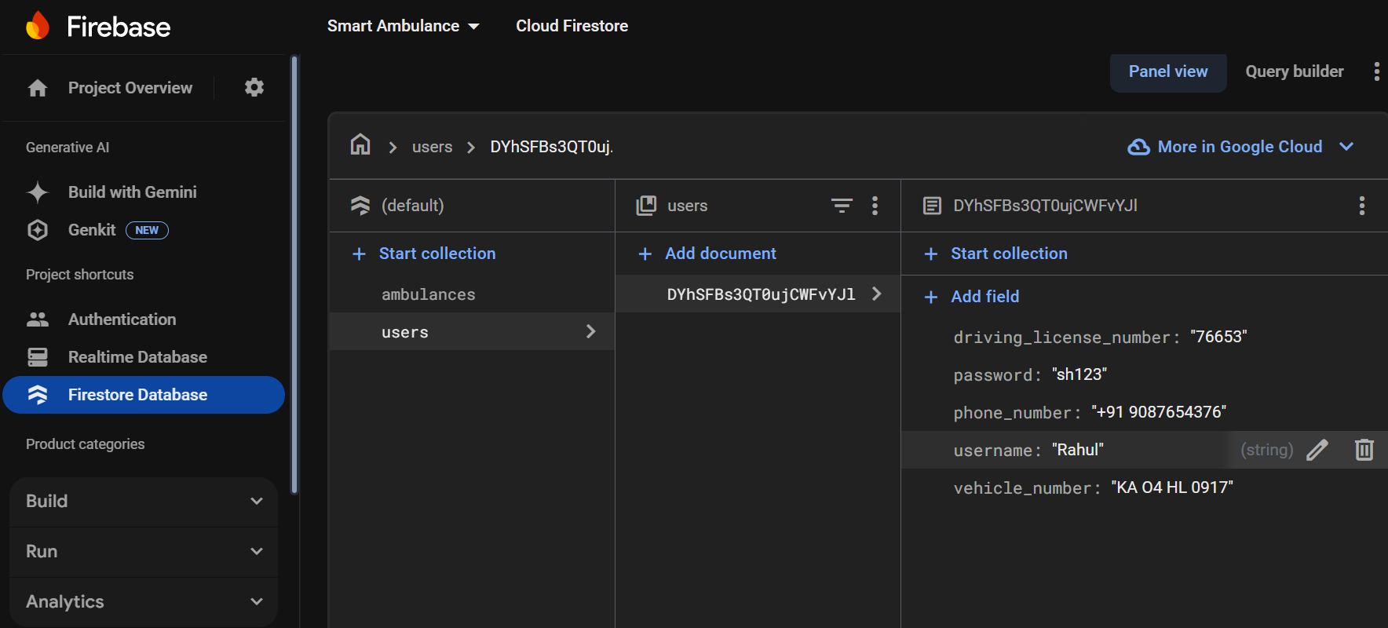
Results
Ambulances Record
Users record

Slide 11
Conclusion
In conclusion, this research aims to develop a Smart Ambulance Dispatch System that improves emergency medical services by integrating real-time GPS technology with user-friendly platforms for drivers and users. By utilizing real-time gps integration,the system effectively reduces response times and enhances operational efficiency.The system sets a benchmark for future innovations in emergency response, emphasizing the importance of timely medical assistance.

Slide 12
Future Enhancements
•AI-Based Ambulance Allocation: Dynamically dispatching an ambulance considering factors like traffic, proximity, and availability can increase efficiency with AI algorithms.
•Hospital Systems Integration : It connects ambulances with hospitals, giving them the status of the patient and the readiness status of the hospital to take on the patient.
•Intelligent health monitoring: equipping ambulances with equipment that will track patients and will transmit in real time vital signs to the hospital.
•Multi-Language Support: Extending language options to suit the diverse population and increase usability in rural and urban areas.

Slide 13
References
Barbeau, S.J., Labrador, M.A., Winters, P.L., Pérez, R., and Georggi, N.L.: ‗Location API 2.0 for J2ME–A new standard in location for Java-enabled mobile phones‘, Computer Communications, 31, (6), pp.1091-1103, 2008.
Cooke, R.: ‗The role and impact of transport on rural communities accessing the state health care system in south africa‘, rural health advocacy project, 2013.
Phillips, A., Schroth, F., Palmer, G.M., Zielinski, S.G., Smith, A.P., and Cunningham. ‗Locationbased services‘, Google Patents, 2010.
Siruma, A., Hornby, D., Srinivas, S. An Assessment of Maternal Health Issues in Two Villages in the Eastern Cape Province of South Africa. Int. J. Environ. Res. Public Health 2014, 11, 9871-9884.

Slide 14
References
BhandariParchi, DalviKasturi and ChopadePriyanka,”Intelligent Accident –Detection And Ambulance -Rescue System,” in International Journal of Scientific and Technology Research, 6th June 2014.
SabyasachiPatra, KarishmaVelisetty and Prathamesh Patel, “Location Based Tracking,” in International Journal of Engineering Research and Development,12th Feb 2014.
Poonam Gupta ,Satyasheel Pol , Dharmanath Rahatekar, Avanti Patil “Smart Ambulance System” International Journal of ComputerApplications (0975 – 8887)
https://ieeexplore.ieee.org/document/8661960
Bassey Isong and Nosipho Dladlu, Tsholofelo Magogodi, “Mobile-based Medical Emergency Ambulance Scheduling System”, Vol. 11, pp. 14-22, 2016.

Slide 15
Thank You

